Slide 1
English Writing:
The Process to Progress
progress
Josh Purse
Busan Science High School

Slide 2
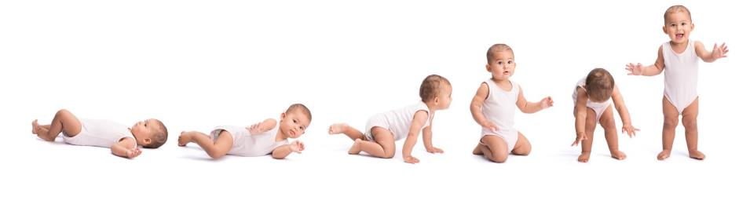
What is process writing?
A step-by-step approach to teaching writing,
in which the focus is on the process,
not just the end product.

Slide 3
Why might process writing
be particularly effective for
English Learners (in Korea)?
Chat with the teachers in your group for 2 minutes, and try to make a list of reasons on your handout.
Now choose just one reason, and write it on your white board.

Slide 4
Benefits of Process Writing
for English Learners
Low-stakes Language Production
Opportunities for Differentiation
Repetition
Integration of All Language Skills
Discouragement of Plagiarism
Authentic and Practical Grammar
Varied Audience
Formative/Summative Assessment
Evidence of Progress = Confidence
Highlights the importance of planning, drafting, revising, etc.
Formative and Summative Assessment
Creates 1-on-1 opportunities for students who need it
(Depth vs. Breadth)
High-level students can focus more on contents, while low-level students can focus on mechanics.
Lots of check-in chances
Peer interaction – Different Audiences
Provides real evidence of progress
Notes:
There is no grade on their practice paragraph or their brainstorming or their first draft.
Check-ins, Word/Paragraph Counts, Feedback, Credit for Progress!
Depth vs. Breadth
Writing, Reading, Listening, Speaking
Stop plagiarism before it starts.
Grammar not in theory, but in practice.
Usually only teacher sees their work.
Chances to formatively assess.
Language learning is hard and can make you want to quit…

Slide 5

The Three Enemies of Language Learning
1. Passiveness
2. Pride
3. Papago
3. Perfectionism
Highlights the importance of planning, drafting, revising, etc.
Formative and Summative Assessment
Creates 1-on-1 opportunities for students who need it
(Depth vs. Breadth)
High-level students can focus more on contents, while low-level students can focus on mechanics.
Lots of check-in chances
Peer interaction – Different Audiences
Provides real evidence of progress

Slide 6

Who has the greatest English ability in history?

Slide 7
English Ability
Shakespeare
Std. C
Josh
Std. A
Perfection is a myth.
Our target is progress.
Std. B

Slide 8
Lesson 1:
What’s a Paragraph?

Slide 9
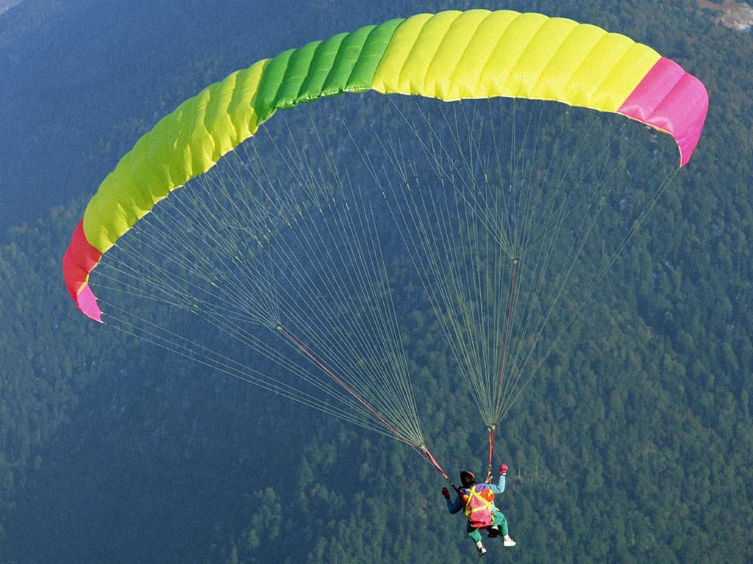
What is a paragraph?
parachute

Slide 10
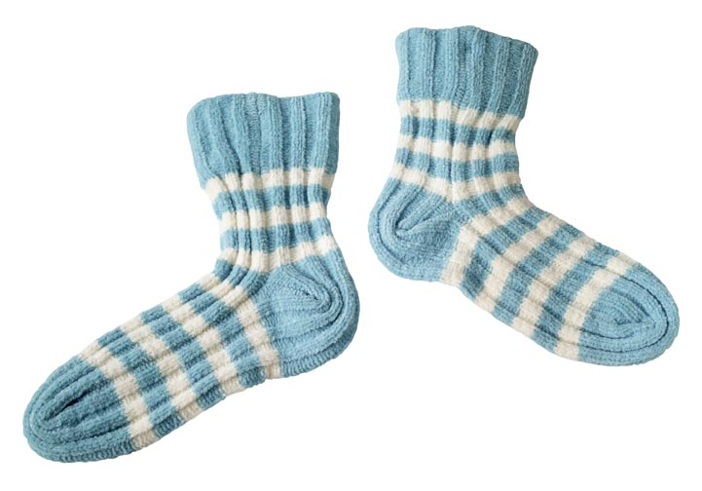
What is a paragraph?
pair of socks

Slide 11
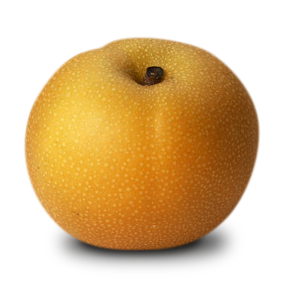
What is a paragraph?
pear

Slide 12
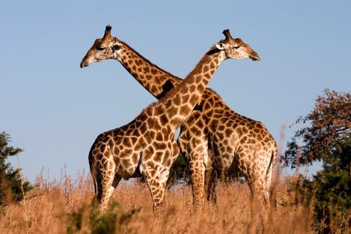
What is a paragraph?
pair of giraffes

Slide 13
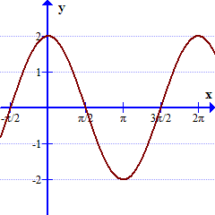
What is a paragraph?
pair of graphs

Slide 14
Yes, I am a paragraph!
문단

Slide 15
This is a paragraph. A paragraph is a group of connected sentences about one particular subject or idea. For example, this paragraph is about paragraphs.
When writers start a new paragraph, they must show the reader. One way to show the reader looks like this. Can you see how the writer showed the reader?
This is a paragraph. A paragraph is a group of connected sentences about one particular subject or idea. For example, this paragraph is about paragraphs.
When writers start a new paragraph, they must show the reader. One way to show the reader looks like this. Can you see how the writer showed the reader?

Slide 16
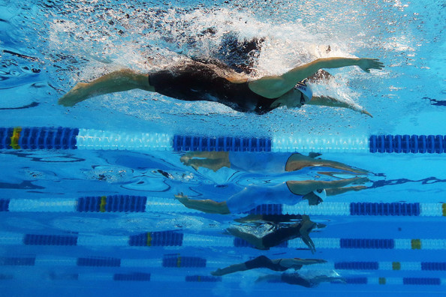
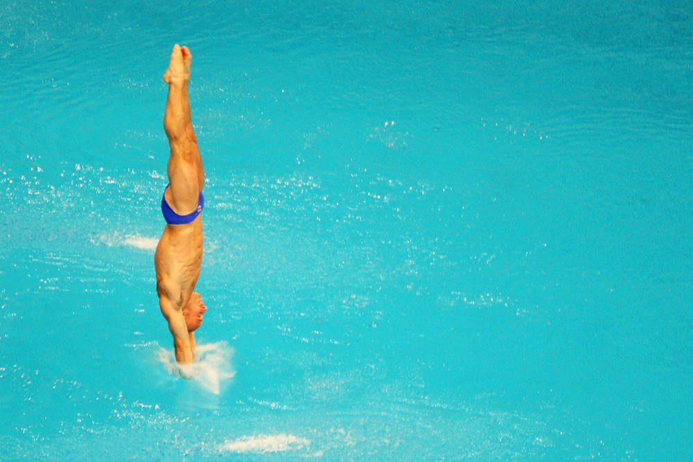
I. Paragraph Spacing
Choose one: Swim or Dive

Slide 17
A. Swim
This is a paragraph. A paragraph is a group of connected sentences about one particular subject or idea. For example, this paragraph is about paragraphs.
When writers start a new paragraph, they must show the reader. One way to show the reader looks like this. Can you see how the writer showed the reader?
(Tab)

Slide 18
B. Dive
This is a paragraph. A paragraph is a group of connected sentences about one particular subject or idea. For example, this paragraph is about paragraphs.
When writers start a new paragraph, they must show the reader. One way to show the reader looks like this. Can you see how the writer showed the reader?
(Enter)

Slide 19
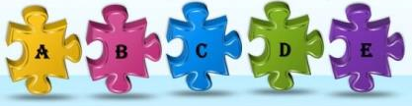
II. Paragraph Contents
- Logical order
Each sentence should connect to the previous sentence.
- Transition words are helpful.
(Then, Next, After, However, Plus, Also …)

Slide 20
pause
ll

Slide 21
Activity 1
Where should we
end one paragraph and start a new one?

Slide 22
Activity 2
Which sentence does not belong in the paragraph?

Slide 23

Introduction Paragraph

Slide 24
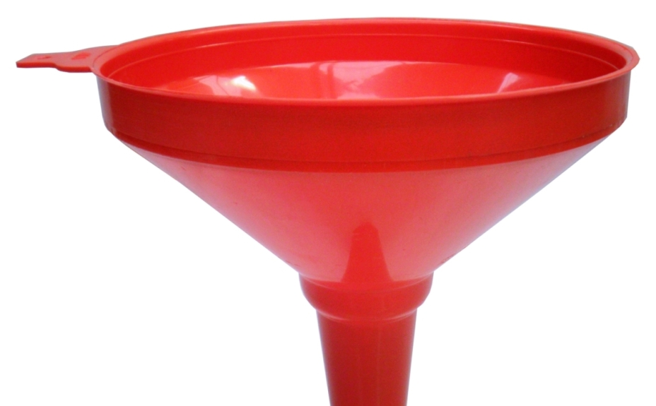
One Method: The Funnel
U N I V E R S E
E A R T H
A S I A
K O R E A
BUSAN

Slide 25

My experience at the World Cup
How could
I begin my introduction paragraph?

Slide 26
S P O R T S
Basketball
Football
Soccer
Premiere League
World Cup
K-League
2014 Brazil
2002 Korea/Japan
2018 Russia
Fan 1
Fan 2
Fan 1,000,000
Me
My experience at the 2014 World Cup in Brazil

Slide 27
Practice writing introductions
Topic choices:
An important invention
(cell phone, car, Internet, contact lens, etc.)
OR
Best way to reduce stress

Slide 28
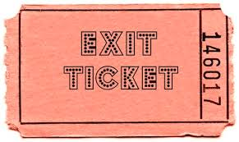
Collect practice introduction paragraphs
as exit tickets.
Hello! I am an opportunity for Formative Assessment!

Slide 29
Lesson 2:
How to write about a memorable experience

Slide 30
1. Fun way to introduce assignment
M_____________ E_____________
Memorable Experiences
SCUBA diving in Malaysia
Flooding my office
Breaking my foot in high school
Moving to Korea
???
scariest
most embarrassing
most disappointing
most exciting
proudest

Slide 31

2. Brainstorming
It’s ok to write in English or Korean!

Slide 32

3. Give an ambitious model
Differentiation!
Students should highlight and label different parts of your model essay.

Slide 33

Signpost Sentence
I’d like to share a little bit about my 5-day bike journey through Korea with friends.

Slide 34

4. Choose topic and begin to organize

Slide 35
Lesson 3:
Writing Day
*Students write, using completed outlines
*Mini-conferences
Hello! I am an opportunity for Formative Assessment!

Slide 36
My university professor:
editing
“Writing is _________.”
Student responses:
creating
understanding
typing
writing
torture
life

Slide 37
Lesson 4:
Reader Response
*Students bring 2 copies of their 1st Draft
(1 for students, 1 for teacher)
*Explain procedure/rules to students
Hello! I am an opportunity for Formative Assessment!

Slide 38
What are the rules?

Slide 39
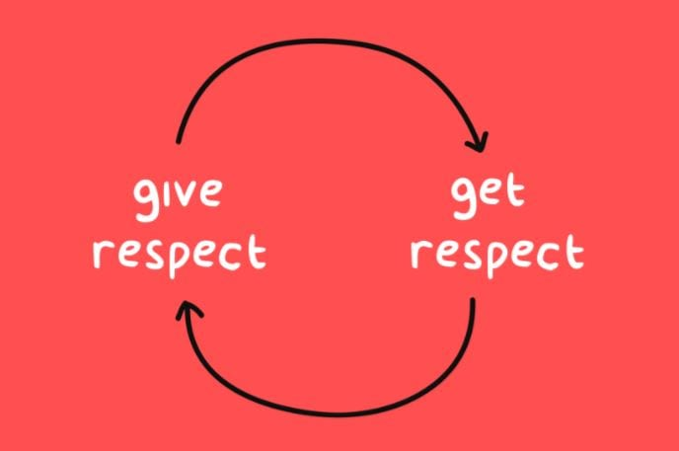
Respect your classmates’ work.

Slide 40

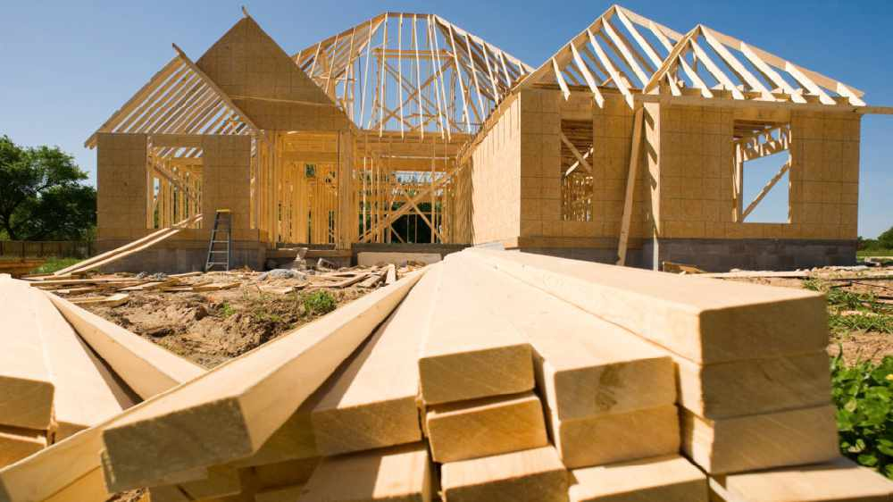
2. Give Constructive Feedback ☺

Slide 41
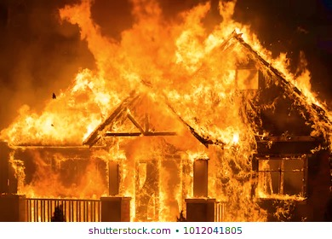
2. (Not Destructive Feedback ☹)

Slide 42
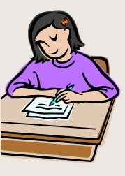
2. For Constructive Feedback …
Give Suggestions
Make Corrections
Give Compliments

Slide 43
After Reader Response …
Update requirements for 2nd Draft
Use the 2nd Draft as a basis for summative assessment

Slide 44
A note on summative assessment
Organization, Contents, Word Choice, Grammar, etc.
80-90%
Growth and Development (Process!)
10-20%

Slide 45
Feedback from Josh
Give some direct, some indirect feedback.
Generally ignore capitalization and articles.
Use pencil, add positive comments along with corrective feedback.
Use corrected grammar point within teacher comments.
Differentiate feedback depending on student.
Use the 2nd Draft as a basis for summative assessment.

Slide 46
Lesson 5 (or 6):
Portfolio Prep
*Explain feedback
*Review requirements (including self-evaluation)
*More mini-conferences
Hello! We are two more opportunities for Formative Assessment!

Slide 47
Lesson 6 (or 5):
Error Correction Game

Slide 48
Mistakes
Learning Opportunities

Slide 49
1. Tense
I created this awesome PPT presentation last week.
I create this awesome PPT presentation
last week.
My family ______ on vacation every year.
Last year, we ______ to Jeju for one week.
My family goes on vacation every year.
Last year, we went to Jeju for one week.
*verb = to go

Slide 50
2. Agreement
In my opinion, my experiences in the USA was wonderful!
I didn’t learn nothing from the presentation.

Slide 51
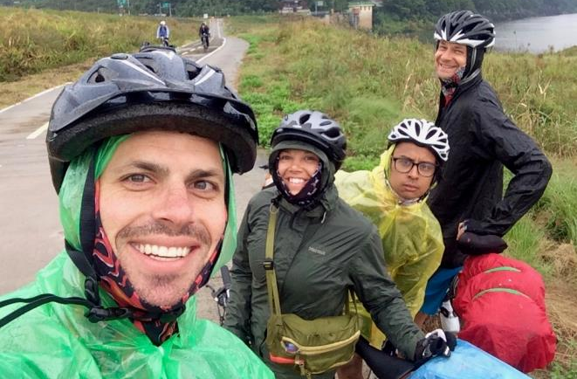
3. Groups of People
Me
Friends

Slide 52
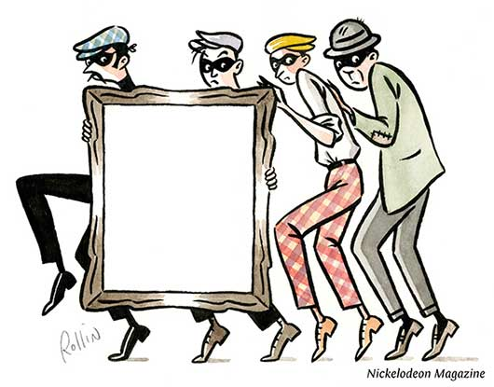
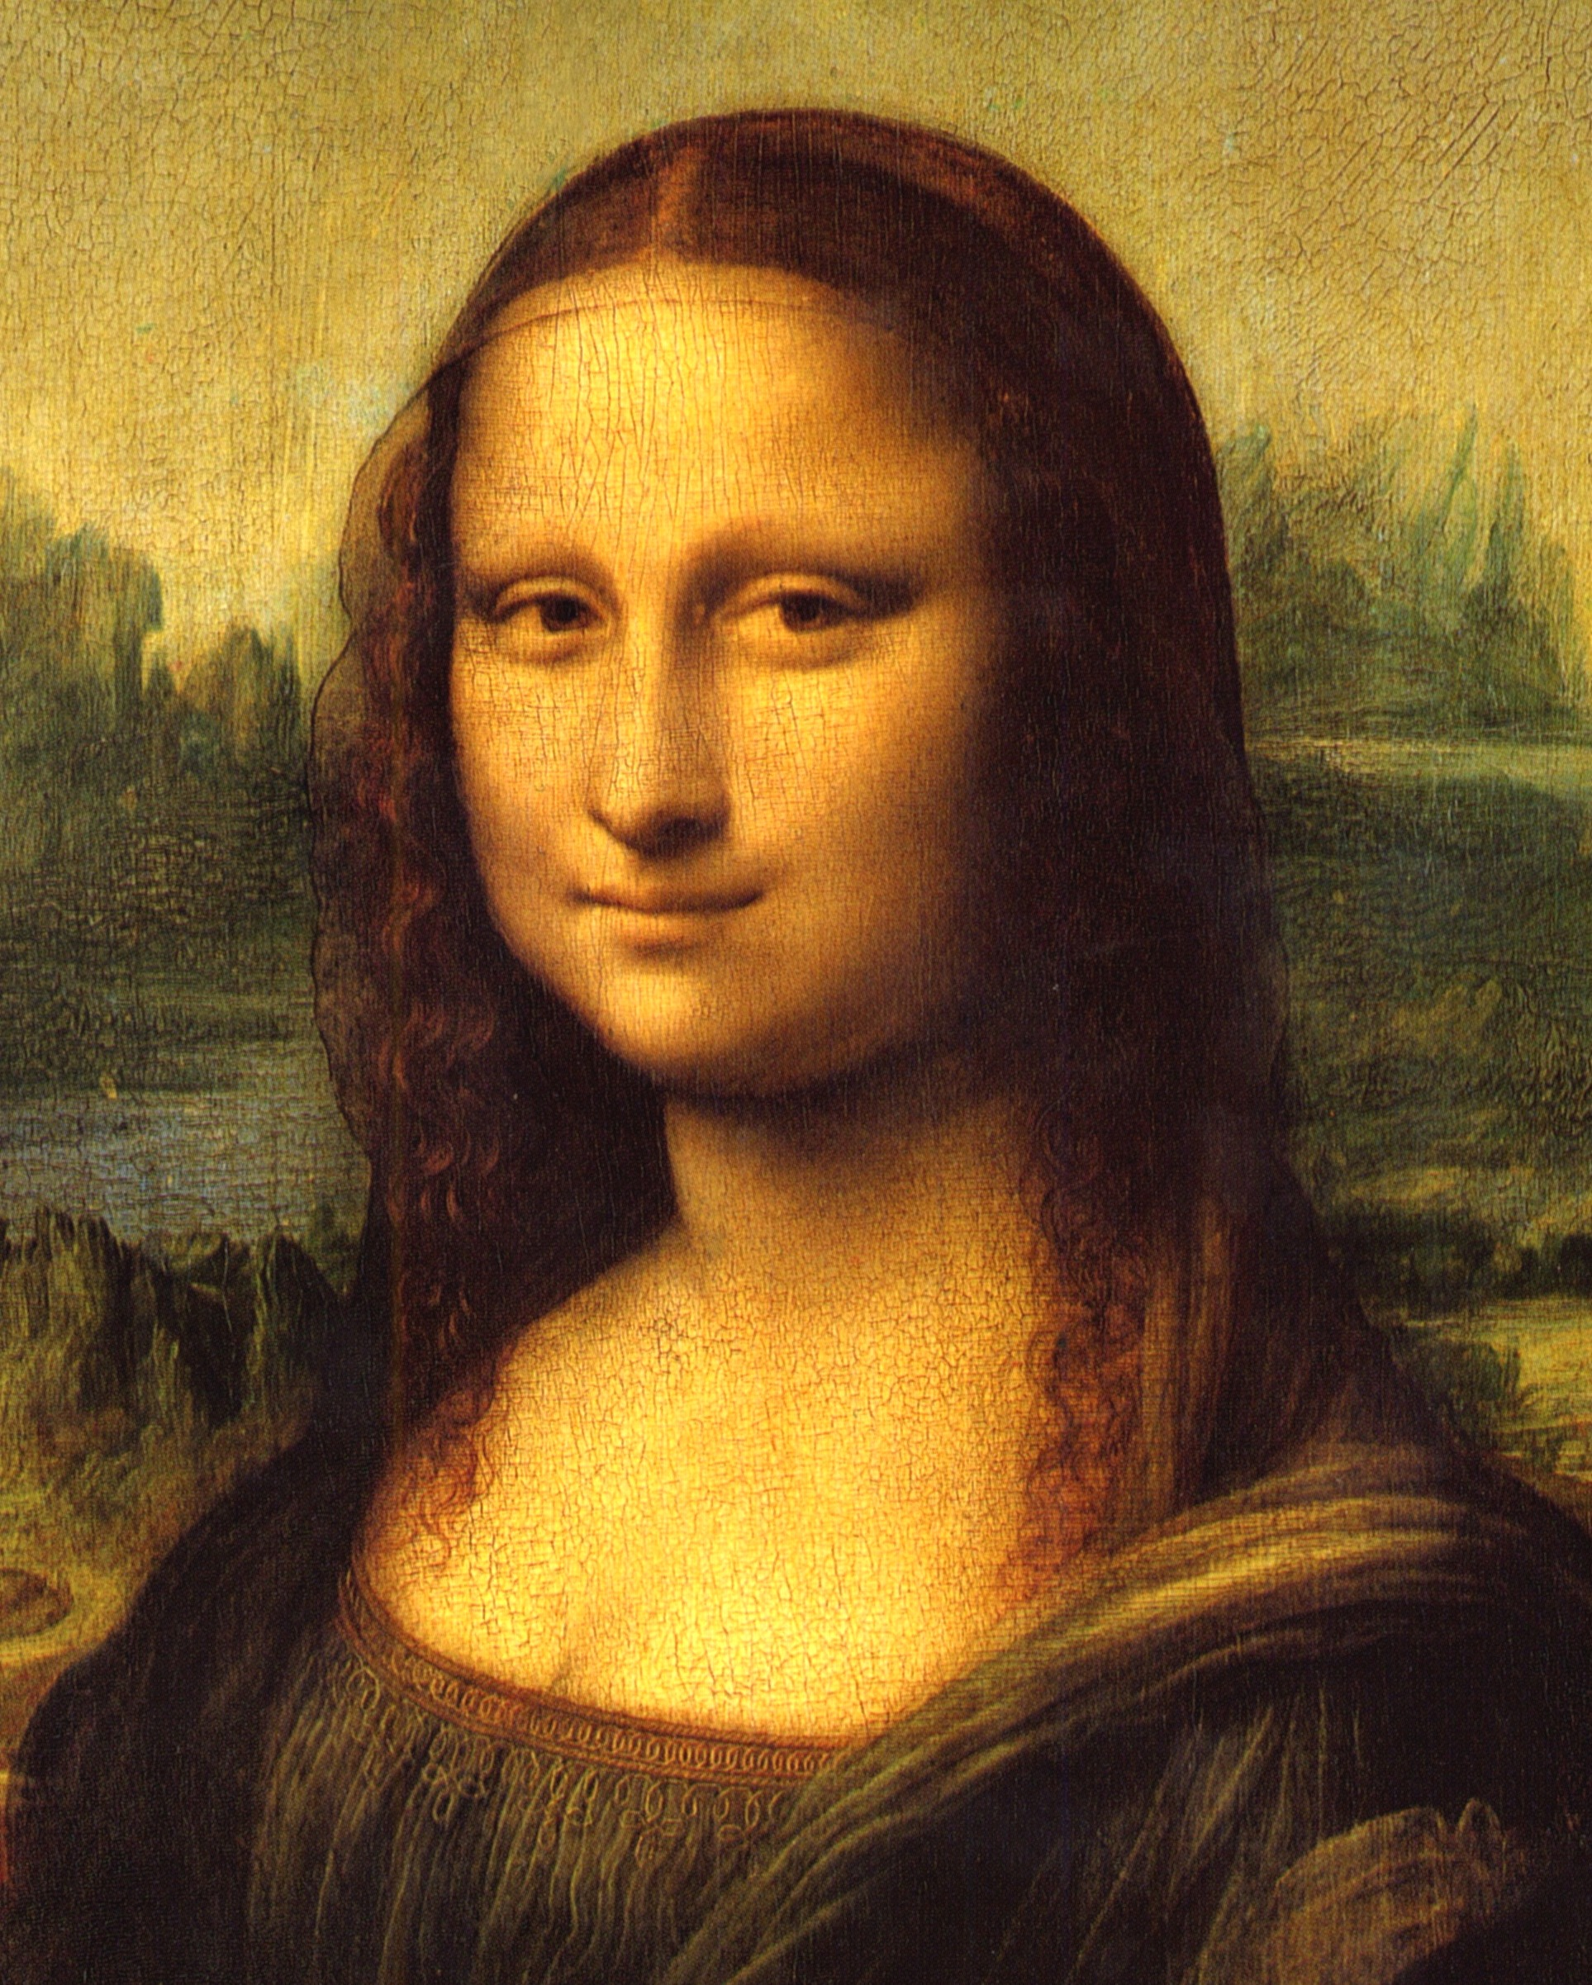


Subject (we):
My friends and I
stole a painting.
Subject (we):
stole a painting.
Object (us):
The police officer arrested
.
Object (us):
The police officer arrested
my friends and me .

Slide 53


Inspect and Correct
Search for errors, and then write the correct answer on on your white board.
Don’t let other groups see your answers.

Slide 54

Other rules:
Each team gets 2 rolls maximum that can be used after a correct answer.
EVEN
6 = Double Points
4 = +40
2 = +20
ODD
5 = Lose All Points
3 = -30
1 = -10

Slide 55
Inspect
We can cure our disease by seeing doctor and eating medicine, or by taking a rest.
Hint: You should fix both bold parts.
10 points

Slide 56
Correct
We can cure our disease by seeing a doctor and taking medicine, or by taking a rest.
10 points

Slide 57
Inspect
Most of people have goals that they want to achieve.
Hint: You should remove one word.
10 points

Slide 58
Correct
Most x people have goals that they want to achieve.
10 points

Slide 59
Inspect
After 5 km, I had to control my speed, body condition, mental, and other many things.
Hint: You should fix all three bold parts.
20 points

Slide 60
Correct
After 5 km, I had to control my speed, body condition, mind, and many other things.
20 points

Slide 61
Inspect
And my parents were dual income.
Hint: parents both h_______ j_______.
OR parents both ________.
20 points

Slide 62
Correct
And my parents both had jobs.
And my parents both worked.
20 points

Slide 63
Inspect
We had to participate an audition to be selected for team.
Hint: You should add two words.
20 points

Slide 64
Correct
We had to participate in an audition to be selected for the team.
20 points

Slide 65
Inspect
Second, I went to the Nagasaki,
where damaged by atomic bomb.
Hint: You should add one word, remove one word, and fix the bold part.
30 points

Slide 66
Correct
Second, I went to Ø Nagasaki,
which was damaged by an atomic bomb.
30 points

Slide 67
Inspect
I think KAIST has ideal conditions to study, but the most important thing in KAIST is KAIST can unfold my dream.
Hint: KAIST can h_____ me re______ my dream.
30 points

Slide 68
Correct
I think KAIST has ideal conditions to study, but the most important thing in KAIST is KAIST can help me realize my dream.
30 points

Slide 69
Inspect
I underwent an operation almost immediately. Was the operation hurt? Actually, I was under anesthetics, so I can’t feel anything. But, it was painful after the surgery.
Hint: But, I was ____ ____ after the surgery.
30 points

Slide 70
Correct
I underwent an operation almost immediately. Did the operation hurt? Actually, I was under anesthetics, so I couldn’t feel anything. But, I was in pain after the surgery.
30 points

Slide 71
Inspect
I did CT scan because doctors didn’t know the bones around of my right eye whether broken or not.
40 points

Slide 72
Correct
I had a CT scan because doctors didn’t know whether or not the bones around my right eye were broken.
40 points

Slide 73
Inspect
Better about having a dog was that our home changed noisier and more energetic.
Hint: ______ ______ th_____ about
40 points

Slide 74
Correct
The best / A good thing about having a dog was that our home became noisier and more energetic.
40 points

Slide 75
Inspect
We went to karaoke at last. But at our next room, there were couple friends singing.
Hint: in the ______ ______ ______ ,
30 points

Slide 76
Correct
We went to karaoke at last. But in the next room over / in the room next door, there were couple friends singing.
30 points

Slide 77
Inspect
We walked onto the stage, and there were so many audiences.
40 points

Slide 78
Correct
We walked onto the stage, and there were so many people in the audience.
40 points

Slide 79
Inspect
When I was a kid, I loved adventure. Columbus, who is the pronoun of adventure, is one of my favorite figures.
Hint: who is the i______ / s_______ of adventure.
40 points

Slide 80
Correct
When I was a kid, I loved adventure. Columbus, who is the icon / symbol of adventure, is one of my favorite figures.
40 points

Slide 81
Questions?
See busanteacher.com for PPT

