Slide 1
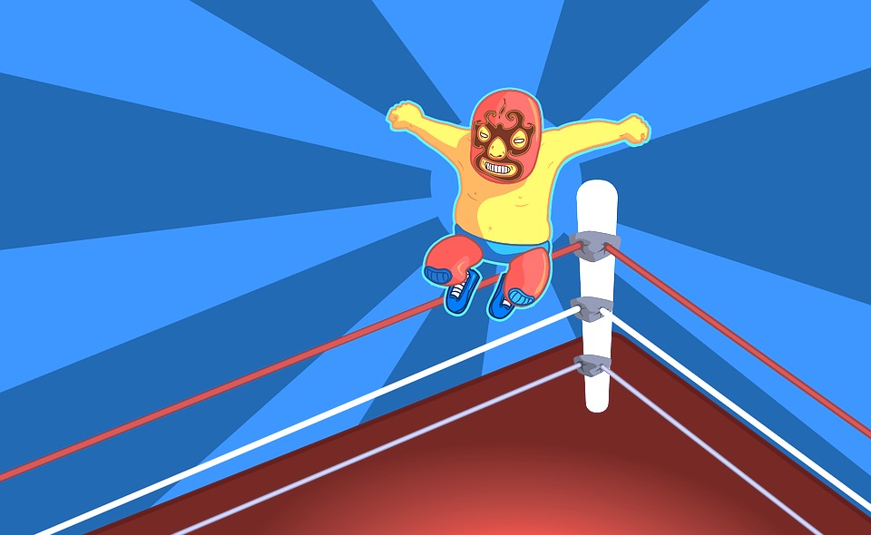
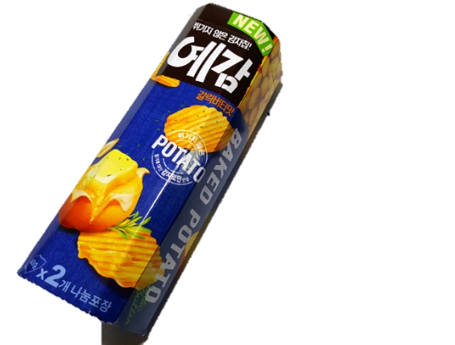
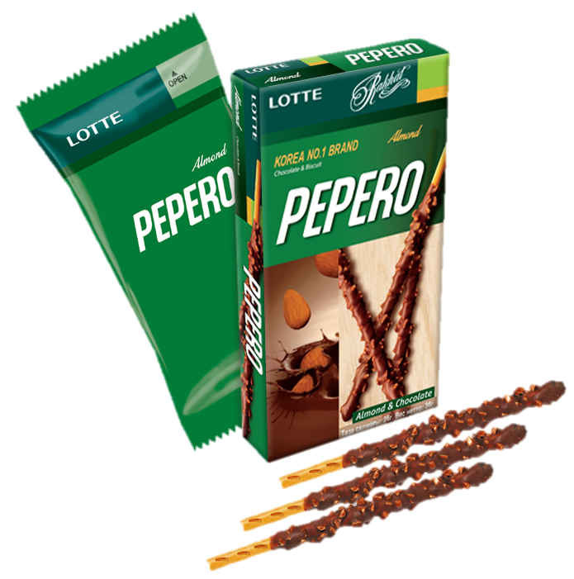
Snack Attack
Snack Attack

Slide 2
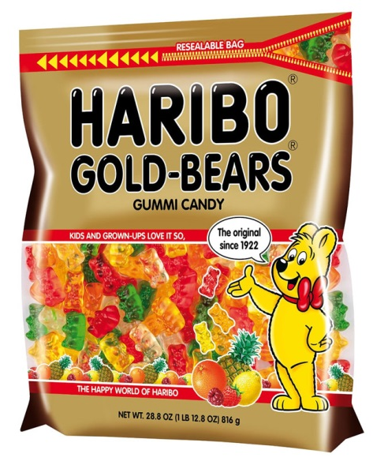
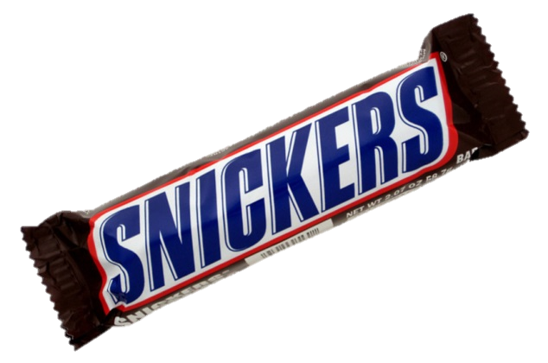

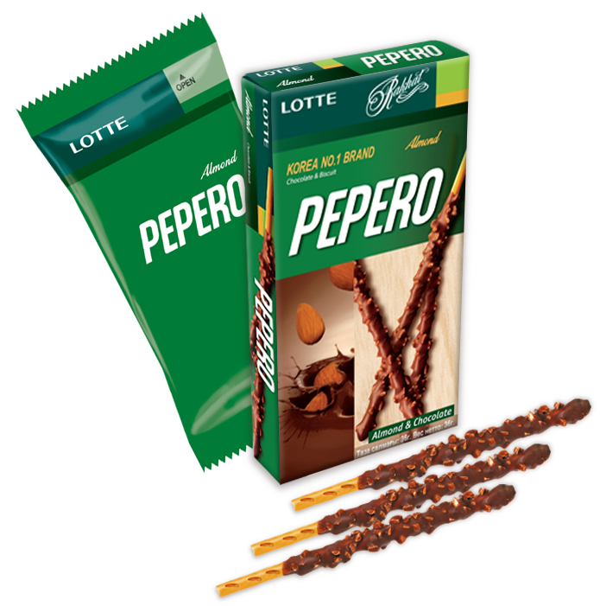
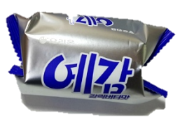
Group 1
Group 2
Group 3
Group 4

Slide 3






“_____ is the best snack in the
world for 5 main reasons.”

Slide 4
Snack Script
“_____ is the best snack in the world
for 5 main reasons.
REASONS (First, Next, etc.)
And that’s why _____ is the best snack!”

Slide 5
Snack Rebuttal Script
“_____ is NOT the best snack in the world.
They said … but actually …
And that’s why _____ is definitely NOT
the best snack!”

